Slide 1
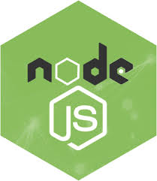

Slide 2
Node js Overview
Node.js is an open source, cross-platform runtime environment for developing server-side and networking applications
Node.js is a server-side platform built on Google Chrome's JavaScript Engine (V8 Engine).
Node.js applications are written in JavaScript, and can be run within the Node.js runtime on OS X, Microsoft Windows, and Linux
Note : Node.js = Runtime Environment + JavaScript Library
Notes:
Node js
Node.js is a server-side platform built on Google Chrome's JavaScript Engine (V8 Engine).
Node.js is an open source, cross-platform runtime environment for developing server-side and networking applications
Node.js applications are written in JavaScript, and can be run within the Node.js runtime on OS X, Microsoft Windows, and Linux
Node.js = Runtime Environment + JavaScript Library
Why Node JS?
Here, I am going to show why node js is useful for you.
1. Free from deadlocking Process – All language bound to the process and if any code needs more processes to execute code, your server will take the time to respond. In this case, a node is free from that blocking.
2. Event Driven Programming – The task is performed based on the events performed is called Event Driven programming and Node JS is using the same concept.
3. Nonblocking I/O – Node JS is not blocking any of input or output so after you pass input, server will not block resources until getting the output. After making the request, you can move further to handle another request. Node Js handles 10x I/O than the other servers.
4. Easy to build the scalable application – Nowadays scalability is the core part of development so an application can be scale anytime.
5. Same language(JS) for both backend and frontend – This is a very interesting thing as if you know Node JS, you can use it for backend and frontend development.
6. Large open source package System(NPM) – Node JS package system is very large so you get more of developed code ready on the spot. Just you have to learn how the package works and integrate it. That’s it.
Hosting – Now many hosting providers support Node JS Hosting so you can deploy Node JS app with one click only so you don’t need to work more.
7. A big corporate is taking care of project(Joyent) – As Joyent is big corporate, Node JS provide stability of framework.
8. Easy to build real-time application – You can real-time broadcasting, push notification with Node JS very easily.So, These are the benefits of Node JS and are the reasons of the Node JS popularity.

Slide 3
What is unique about Node.js?
JavaScript used in client-side but node.js puts the JavaScript on server-side thus making communication between client and server will happen in same language.
Servers are normally thread based but Node.JS is “Event” based.
Notes:
What is unique about Node.js
JavaScript used in client-side but node.js puts the JavaScript on server-side thus making communication between client and server will happen in same language
Servers are normally thread based but Node.JS is “Event” based. Node.JS serves each request in a Evented loop that can able to handle simultaneous requests

Slide 4
What is unique about Node.js?
JavaScript used in client-side but node.js puts the JavaScript on server-side thus making communication between client and server will happen in same language
Servers are normally thread based but Node.JS is “Event” based. Node.JS serves each request in a Evented loop that can able to handle simultaneous requests
Notes:
What is unique about Node.js
JavaScript used in client-side but node.js puts the JavaScript on server-side thus making communication between client and server will happen in same language
Servers are normally thread based but Node.JS is “Event” based. Node.JS serves each request in a Evented loop that can able to handle simultaneous requests

Slide 5
Specialty of Node.js
Easy to get started.
Used for Agile development
Superfast and highly scalable
Fewer lines of code
Built twice as fast with fewer people
Front end developer can reuse JS skills for backend development.
Large eco system of open-source libraries.
Paypal, Uber, Netflix
Notes:
Features of node,js
Easy to get started.
Used for Agile development
Superfast and highly scalable
Fewer lines of code
Built twice as fast with fewer people
Front end developer can reuse JS skills for backend development.
Large eco system of open-source libraries.
Paypal, Uber, Netflix

Slide 6
Features of Node.js
Asynchronous and Event Driven :
It essentially means a Node.js based server never waits for an API to return data.
Notification mechanism of Node.js help server to get response from API
Very Fast :
Being built on Google Chrome's V8 JavaScript Engine, Node.js library is very fast in code execution.
No Buffering :
Node.js applications never buffer any data. These applications simply output the data in chunks
Notes:
Features of node,js
Asynchronous and Event Driven − It essentially means a Node.js based server never waits for an API to return data. The server moves to the next API after calling it and a
notification mechanism of Events of Node.js helps the server to get a response from
the previous API call.
Very Fast :
Being built on Google Chrome's V8 JavaScript Engine, Node.js library
is very fast in code execution.
No Buffering :
Node.js applications never buffer any data. These applications
simply output the data in chunks

Slide 7
Where to Use Node.js?
I/O bound Applications
Data Streaming Applications
Data Intensive Real-time Applications (DIRT)
Single Page Applications
Notes:
Where to use Node.js
/O bound Applications
Data Streaming Applications
Data Intensive Real-time Applications (DIRT)
Single Page Applications

Slide 8
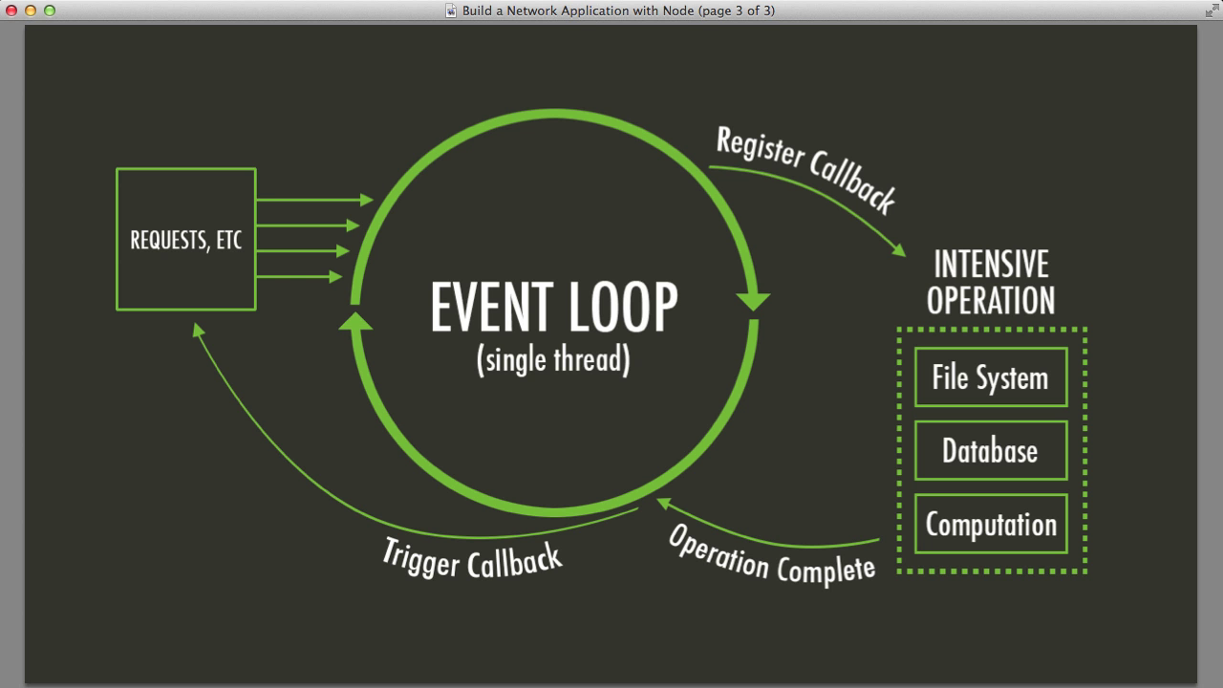

Node.js Event Loop
There are a couple of implications of this apparently very simple and basic model
  Avoid synchronous code at all costs because it blocks the event loop
  Which means: callbacks, callbacks, and more callbacks

Slide 9
Architecture
In 2009 Ryan Dahl created Node.
He took v8 engine and embedded it into C++ program called Node.
Node.exe
R
Run time Environment
V8 Engine
Notes:
Difference:
For example, JS has an object called document. But node is in server side, so it doesn’t have such objects related to a browser.

Slide 10
Node JS
Node is not a programming language or framework.
It’s a runtime environment.
Notes:
Difference:
For example, JS has an object called document. But node is in server side, so it doesn’t have such objects related to a browser.

Slide 11

How Node Works
Highly scalable because of the Asynchronous(non-blocking) nature of node.
Single thread is used to process multiple requests.
Kitchen
waiter
Table 1
Table 2
Notes:
Starting REPL
REPL can be started by simply running node on shell/console without any arguments .
Syntax : $ node
Simple Program at node.js REPL Prompt
$ node
> 1 + 3
4

Slide 12
Asynchronous
Single thread is used to handle all request.
While the db is executing the query, the thread will be used to serve an other request
Single thread
DB Request
File Request
When the db prepares the results, it puts a message to event queue
Notes:
Starting REPL
REPL can be started by simply running node on shell/console without any arguments .
Syntax : $ node
Simple Program at node.js REPL Prompt
$ node
> 1 + 3
4

Slide 13
Asynchronous
Node is continuously monitoring this queue in background
Event Queue
Single thread
Request
Request
This makes node ideal for I/O intensive applications.
Data Ready
Notes:
Starting REPL
REPL can be started by simply running node on shell/console without any arguments .
Syntax : $ node
Simple Program at node.js REPL Prompt
$ node
> 1 + 3
4

Slide 14
Applications
Suitable applications include more disk and network access.
Not suitable for CPU – intensive applications( ex: video encoding, image manipulation services).
Notes:
Starting REPL
REPL can be started by simply running node on shell/console without any arguments .
Syntax : $ node
Simple Program at node.js REPL Prompt
$ node
> 1 + 3
4

Slide 15
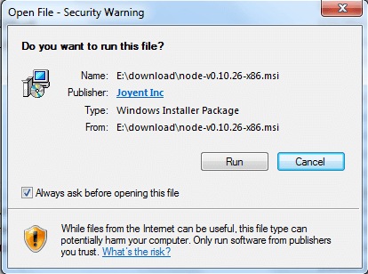
Enviornment setup
Windows Installer (.msi) :
Download 32 bit from here : https://nodejs.org/en/download/
Step - 1 : Double clicking on node-v0.10.26-x86.msi the following screen will come -

Slide 16
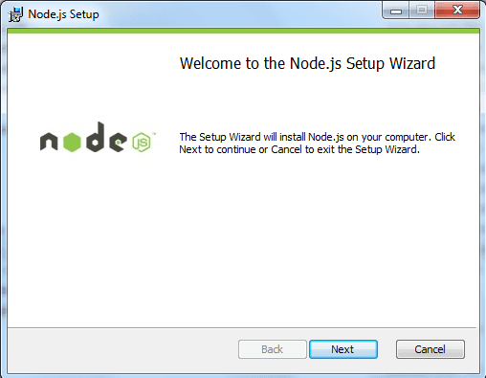
Step - 2 : Clicking on Run button the following screen will come -

Slide 17
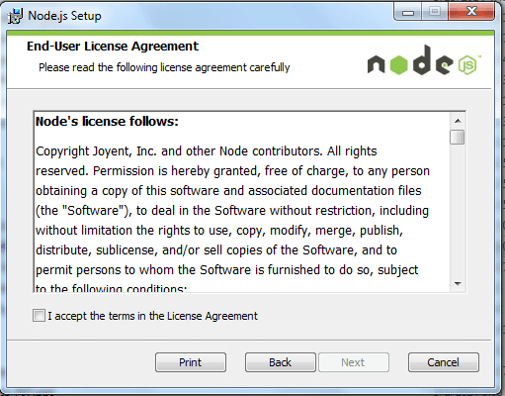
Step -3 : Accept the license agreement and click on next button :

Slide 18
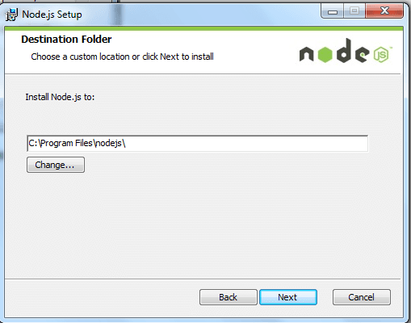
Step - 4 : Here "C:\Program Files\nodejs\" is the default folder name, you can change the folder name. Click on next -

Slide 19
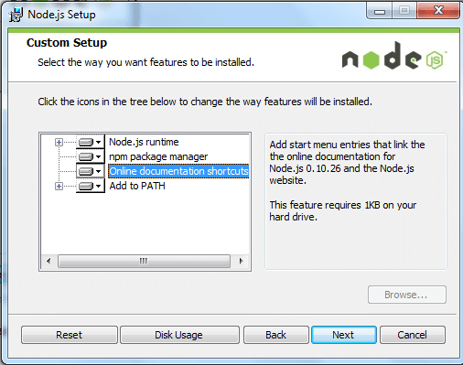
Step - 5 : Click the icons in the tree to change the way features will be installed , Click next -

Slide 20
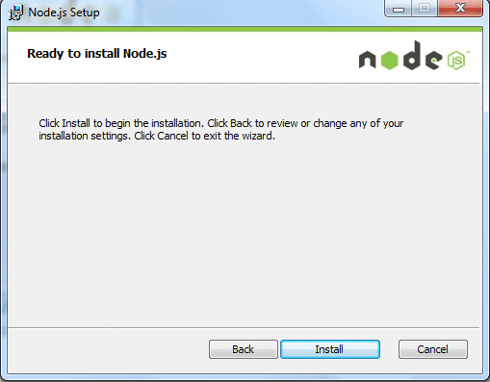
Step-6 : Click Install to begin the installation. Click Back to review or change any your installation settings. Click cancel to exit the wizard :

Slide 21
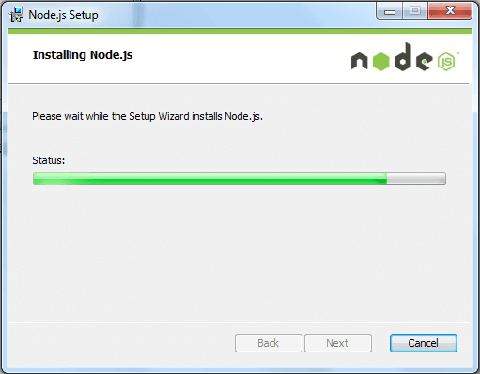
Installation in progress :

Slide 22
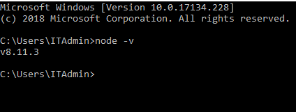
Test your Node.js installation
Open your command prompt:
Windows Key + R
Type “cmd”
Enter “node -v” to display the version number of your Node.js installation
Enter “node -h” to display the help message of Node.js

Slide 23
REPL Terminal
REPL represents a computer environment like a Windows console or Unix/Linux shell where a command is entered and the system responds with an output in an interactive mode
Read - Reads user's input, parses the input into JavaScript data-structure, and stores in memory.
Eval - Takes and evaluates the data structure.
Print - Prints the result.
Loop - Loops the above command until the user presses ctrl-c twice
Notes:
REPL Terminal
REPL stands for Read Eval Print Loop and it represents a computer environment like a Windows console or Unix/Linux shell where a command is entered and the system responds with an output in an interactive mode. Node.js or Node comes bundled with a REPL environment. It performs the following tasks:
● Read - Reads user's input, parses the input into JavaScript data-structure, and stores in memory.
● Eval - Takes and evaluates the data structure.
● Print - Prints the result.
● Loop - Loops the above command until the user presses ctrl-c twice. The REPL feature of Node is very useful in experimenting with Node.js codes and to debug JavaScript codes.

Slide 24
REPL Commands
ctrl + c - terminate the current command.
ctrl + c twice - terminate the Node REPL.
ctrl + d - terminate the Node REPL.
Up/Down Keys - see command history and modify previous commands.
tab Keys - list of current commands.
.help - list of all commands.
.break - exit from multiline expression.
.clear - exit from multiline expression.
.save filename - save the current Node REPL session to a file.
.load filename - load file content in current Node REPL session
Notes:
REPL Commands
ctrl + c - terminate the current command. • ctrl + c twice - terminate the Node REPL. • ctrl + d - terminate the Node REPL. • Up/Down Keys - see command history and modify previous commands. • tab Keys - list of current commands. • .help - list of all commands. • .break - exit from multiline expression. • .clear - exit from multiline expression. • .save filename - save the current Node REPL session to a file. • .load filename - load file content in current Node REPL session

Slide 25
Starting REPL
REPL can be started by simply running node on shell/console without any arguments .
Syntax : $ node
Simple Program at node.js REPL Prompt
$ node
> 1 + 3
4
Notes:
Starting REPL
REPL can be started by simply running node on shell/console without any arguments .
Syntax : $ node
Simple Program at node.js REPL Prompt
$ node
> 1 + 3
4

Slide 26
Node Module System

Slide 27
Hello world
hello.js
console.log(“Hello World!!!”);
Command for executing node program:
      node app.js
      (or)
      node app
Notes:
Hello world
var http = require( 'http' );
http.createServer( function( request, response )
{ response.writeHead( 200, { 'Content-Type' : 'text/plain' } ); response.end( 'Hello World!\n' ); } ).listen( 4140, '127.0.0.1’ );
console.log( 'Server running at http://127.0.0.1:4140/’ );

Slide 28
Function call
function sayHai(name)
{
console.log("Hai "+name);
}
sayHai(‘Sam');
Notes:
Hello world
var http = require( 'http' );
http.createServer( function( request, response )
{ response.writeHead( 200, { 'Content-Type' : 'text/plain' } ); response.end( 'Hello World!\n' ); } ).listen( 4140, '127.0.0.1’ );
console.log( 'Server running at http://127.0.0.1:4140/’ );

Slide 29
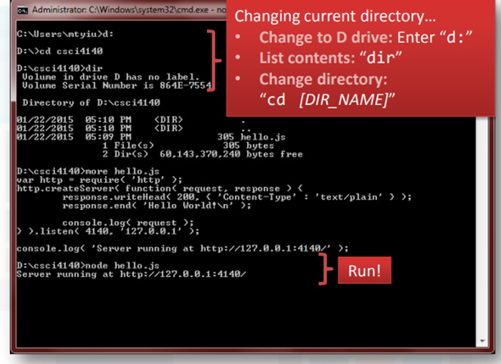
Running the hello world program
Get back to your command prompt again…
• Change the current directory to where hello.js is saved
• Execute “node hello.js” (simple enough?)

Slide 30
Node.js Modules
Module in Node.js is a simple or complex functionality organized in single or multiple JavaScript files which can be reused throughout the Node.js application.
Each module in Node.js has its own context, so it cannot interfere with other modules or pollute global scope.
Also, each module can be placed in a separate .js file under a separate folder.
Node.js implements CommonJS modules standard.
CommonJS is a group of volunteers who define JavaScript standards for web server, desktop, and console application.
Notes:
When you write Node.js applications, you could actually put all your code into one huge index.js file, no matter how large or complex your application is. The Node.js interpreter doesn’t care. But in terms of code organization, you would end up with a hard to understand and hard to debug mess quite quickly. So as a human being, you should care about how to structure your code. This is where modules come in.

Slide 31
Built-in Modules
Os
Fs
Path
Events
http
Etc…

Slide 32
Modularity
Functions and variables should be encapsulated inside the module.
It prevents overriding.
Every file is module in node.
Modules can be reused.

Slide 33
Create Your Own Modules
The following example creates a module that returns a date and time object:
Example
Create a module that returns the current date and time:
function date() {
return Date();
}
module.exports =date;
The exports keyword is used to make properties and methods available outside the module file.
Save the above code as “dateModule.js"

Slide 34
Now you can include and use the module created above in any of your Node.js files.
Example
Use the module “dateModule" in a Node.js file:
var dt = require('./dateModule’);
console.log(dt());
Notice that we use ./ to locate the module, that means that the module is located in the same folder as the Node.js file.

Slide 35
fs module.
Reading Directory
    const fs = require('fs');
    //synchronous
      const files = fs.readdirSync(__dirname);
      console.log(files);

Slide 36
fs module.
Reading Directory
    const fs = require('fs');
    //asynchronous
      fs.readdir('./',function(err,files){
      if(err) console.log('error',err);
      else console.log('result',files);
      });

Slide 37
common I/O operation examples using fs module.
Reading File:
Use fs.readFile() method to read the physical file asynchronously.
Method Signature:
fs.readFile(fileName [,options], callback)
The Parameters are :
filename: Full path and name of the file as a string.
options: The options parameter can be an object or string which can include encoding and flag. The default encoding is utf8 and default flag is "r".
callback: A function with two parameters err and fd. This will get called when readFile operation completes.

Slide 38
Example: Reading File
var fs = require('fs');
fs.readFile('TestFile.txt', 'utf8’, function (err, data) {
if (err) throw err;
console.log(data);
});
The above example reads TestFile.txt (on Windows) asynchronously and executes callback function when read operation completes. This read operation either throws an error or completes successfully. The err parameter contains error information if any. The data parameter contains the content of the specified file.

Slide 39
Use fs.readFileSync() method to read file synchronously as shown below.
Example: Reading File Synchronously
var fs = require('fs');
var data = fs.readFileSync('dummyfile.txt', 'utf8');
console.log(data);

Slide 40
2. Writing File:
Use fs.writeFile() method to write data to a file. If file already exists then it overwrites the existing content otherwise it creates a new file and writes data into it.
Method Signature:
fs.writeFile(filename, data[, options], callback)
Parameters:
filename: Full path and name of the file as a string.
Data: The content to be written in a file.
options: The options parameter can be an object or string which can include encoding, mode and flag. The default encoding is utf8 and default flag is "r".
callback: A function with two parameters err and fd. This will get called when write operation completes.

Slide 41
Example: Creating & Writing File
var fs = require('fs');
fs.writeFile('test.txt', 'Hello World!', function (err) {
if (err)
console.log(err);
else
console.log('Write operation complete.');
});

Slide 42
Node.js HTTP Module
Node.js has a built-in module called HTTP, which allows Node.js to transfer data over the Hyper Text Transfer Protocol (HTTP).
To include the HTTP module, use the require() method:
var http = require('http');

Slide 43
Node.js as a Web Server
The HTTP module can create an HTTP server that listens to server ports and gives a response back to the client.
Use the createServer() method to create an HTTP server:
Example
var http = require('http');
//create a server object:
http.createServer(function (req, res) {
res.write('Hello World!'); //write a response to the client
res.end(); //end the response
}).listen(8080); //the server object listens on port 8080
Notes:
The function passed into the http.createServer() method, will be executed when someone tries to access the computer on port 8080.

Slide 44
Examples
Examples
Create an HTML login page and use http node module to create the server which will serve the page

Slide 45
NPM
NPM is a package manager for Node.js packages, or modules
A package in Node.js contains all the files you need for a module.
Modules are JavaScript libraries you can include in your project.
The NPM program is installed on your computer when you install Node.js
Synatx for Installing Modules Using NPM
$ npm install <Module Name>
.
Notes:
NPM
Node Package Manager (NPM) provides two main functionalities
It provides online repositories for node.js packages/modules which are searchable on search.nodejs.org
It also provides command line utility to install Node.js packages, do version management and dependency management of Node.js packages.
Installing Modules Using NPM
$ npm install <Module Name>
For example, following is the command to install a famous Node.js web framework module
called express:
$ npm install express
Now you can use this module in your js file as following:
var express = require('express');

Slide 46
npm components
npm consists of three distinct components:
the website
the Command Line Interface (CLI)
the registry
Use the website to discover packages, set up profiles, and manage other aspects of your npm experience. For example, you can set up Orgs (organizations) to manage access to public or private packages.
The CLI runs from a terminal. This is how most developers interact with npm.
The registry is a large public database of JavaScript software and the meta-information surrounding it.

Slide 47
Use npm to . . .
Adapt packages of code to your apps, or incorporate packages as they are.
Download standalone tools you can use right away.
Run packages without downloading using npx.
Share code with any npm user, any where.
Restrict code to specific developers.
Form Orgs (organizations) to coordinate package maintenance, coding, and developers.
Form virtual teams by using Orgs.
Manage multiple versions of code and code dependencies.
Update applications easily when underlying code is updated.
Discover multiple ways to solve the same puzzle.
Find other developers who are working on similar problems and projects.

Slide 48
Start project
Npm init
Run project npm start

Slide 49
What is TypeScript
Free and open source, strongly supported by Microsoft
Based on ecmascript 4 + ecmascript 6
Created by the father of C# Anders Hejlsberg
A superset of JavaScript
To answer why we need JavaScript+, we need to understand what's wrong with vanilla JavaScript

Slide 50
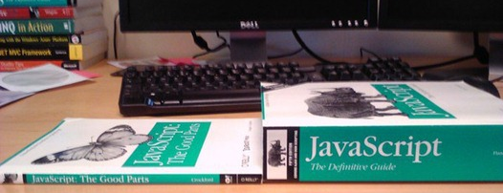
What is the problem
Why do people hate working in JavaScript?

Slide 51
Application scale JavaScript development is hard
not design as a programming language for big application
does not have static typing
lack structuring mechanisms like classes, modules, interfaces

Slide 52
Problem - dynamic types
Variables are untyped and dynamic. They are flexible
Bad because it is so easy to get wrong
var x = 1; var y = x + 1;
// OK, type is inferred. can assume x and y are both numbers.
var x = 1; x = "hello";
// NOT OK, type is mixed up. We can't assume what type is x.
// JS is interpreted. There are no design-time intellisense or compile-time assistance to help you point out errors

Slide 53
TypeScript Key Features
Support standard JavaScript code with static typing
Zero cost: Static types completely disappear at run-time
Encapsulation though classes, modules and interfaces
Constructors, properties and functions (public, private)
Readability

Slide 54
Install
npm install –g typescript
Compile and run
tsc filename.ts
node filename.js

Slide 55
Type Annotation
Any
  Any Type is a super set of all types
    var x : any;
    var y;
Primitive
  Number
    Does not have separate integer and float/double type.
    var num : number = 20;
    var num = 20;
  String
    Both single quote or double quotes can be used.
    var name : string = “hello”;
    var name =’hello’;
  Bool
    var isOpen =true;
Notes:
All numbers in Typescript are floating point values.
These floating point numbers get the type 'number'.

Slide 56
Type Annotation
Void
  Used as the return type of functions that don’t return any value
Object Types
  class, interface, module.
Array
  Array types can be written in:
    var list: number[] = [1, 2, 3];
    var list: Array<number> = [1, 2, 3];
    var list:any[] = [1, true, "free"]
Enum
    enum Color { Red, Green, Blue };
    var color = Color.Blue;

Slide 57
Type Annotation
Tuple
  Tuple types allow you to express an array where the type of a fixed number of elements is known.
    var x: [string, number];
    x = ['hello', 10];
    Employee:[number,string][]
    employee=[
    [1, 'joe'],
    [2,'sam']
    ]
Notes:
automatic semicolon insertion

Slide 58
Enum
enums allow us to declare a set of named constants i.e. a collection of related values that can be numeric or string values.
enum PrintMedia {
Newspaper,
Newsletter,
Magazine,
Book
}

Slide 59
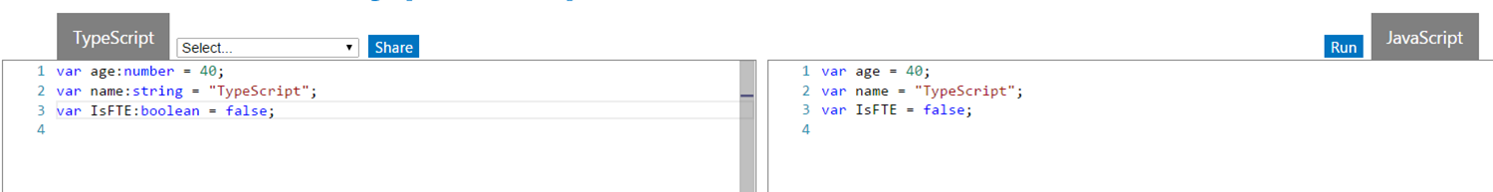
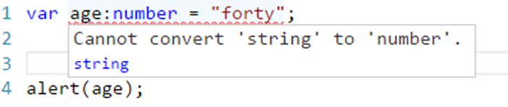
Type Annotation
Design time feature. No additional code is emitted in the final JavaScript that TypeScript compiler produces.
If there’s a type mismatch TypeScript shows a warning.

Slide 60
Functions
Type Annotation for parameter and return type.
function addnum(x:number, y:number):number{
return x+y;
}
Notes:
-we can also pass functions in functions as arguments

Slide 61
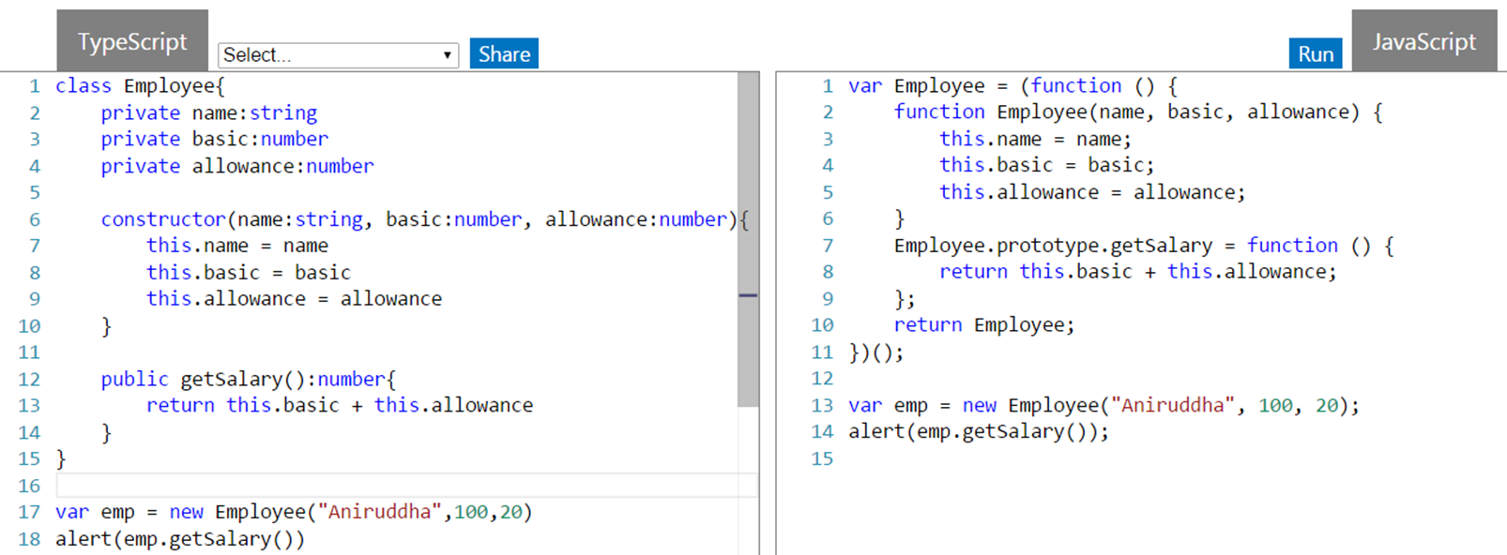
Class
Properties and fields to store data
Methods to define behavior

Slide 62
TYPESCRIPT - CLASS
The class in Typescript is compiled to plain JavaScript functions by the Typescript compiler to work across platforms and browsers.
A class can include the following:
Constructor
Properties
Methods

Slide 63
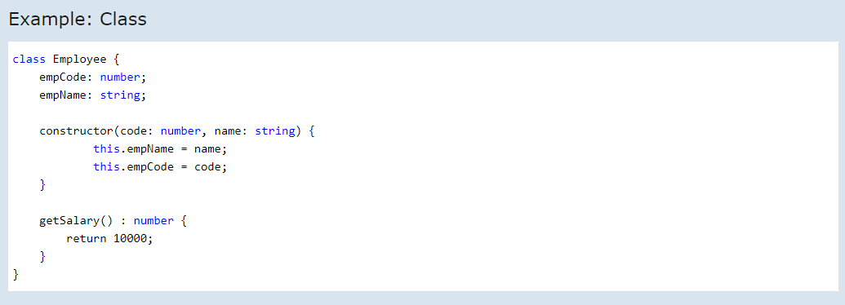
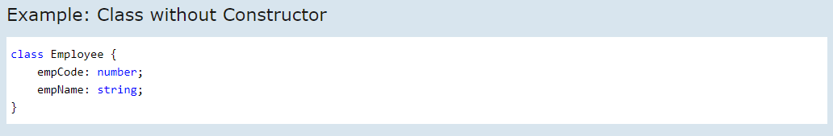
It is not necessary for a class to have a constructor.

Slide 64
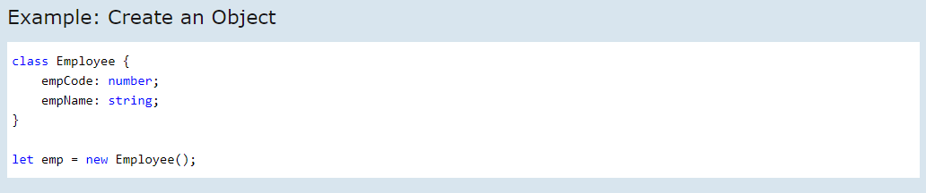
CREATING AN OBJECT OF CLASS
An object of the class can be created using the new keyword.
Here, we create an object called emp of type employee using let emp = new employee();. The above class does not include any parameterized constructor so we cannot pass values while creating an object. If the class includes a parameterized constructor, then we can pass the values while creating the object.

Slide 65
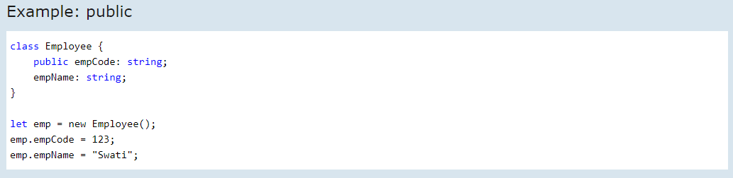
TYPESCRIPT - DATA MODIFIERS
In object-oriented programming, the concept of 'encapsulation' is used to make class members public or private i.e. A class can control the visibility of its data members. This is done using access modifiers.
There are three types of access modifiers in typescript:
public, private and protected
Public
By default, all members of a class in Typescript are public. All the public members can be accessed anywhere without any restrictions.

Slide 66
Inheritance
Typescript supports inheritance of class through extends keyword
super keyword.
Class child_class extends parent_class{
}

Slide 67
Module
Modules can be defined using module keyword.
A module can contain sub module, class, interface or enum.
Class, Interfaces , functions can be exposed using export keyword.
Adding file references. - /// <reference path=“filename.ts" />

Slide 68
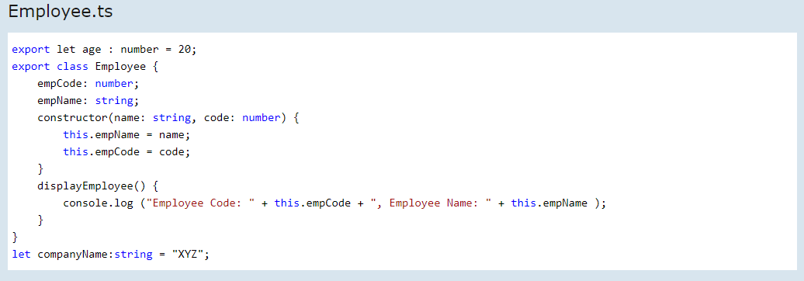
TYPESCRIPT - MODULE
A module can be defined in a separate .tfile which can contain functions, variables, interfaces and classes. Use the prefix export with all the definitions you want to include in a module and want to access from other modules.
Export

Slide 69
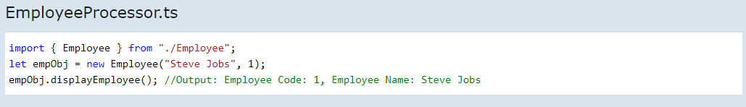
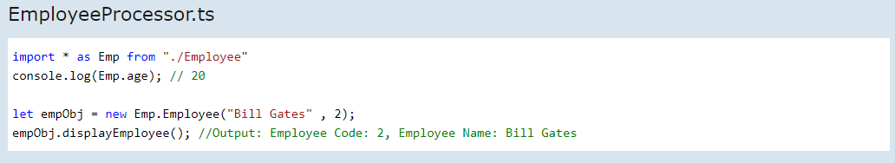
IMPORT
A module can be used in another module using an import statement.
Let's see different ways of importing a module export.
* Single export from a Module
* Entire Module into a Variable

Slide 70
Interface
Declared using interface keyword
TS compiler shows error when Interface signature and implementation does not match
interface interface_name {
// variables' declaration
// methods' declaration
}

Slide 71
interface Person {
name:string
age:number
}
class Employee implements Person {
name="sam";
age=25;
}
let e=new Employee()
console.log(e.name);

Slide 72
References
A curated Play list for MEAN Stack https://youtube.com/playlist?list=PLI3klu98qaepWeUtjpVuNYwrIyZQlXJy-
https://cs.lmu.edu/~ray/notes/javascript/
https://developer.mozilla.org/en-US/docs/Web/JavaScript/Guide

